Slide 1
Economic Growth Model
MATLAB, Simulink and App Designer Implementation

Slide 2
INTRODUCTION
Economic growth is a key topic in macroeconomics, as it determines long-term economic development. The Solow growth model provides a simple framework for analyzing how capital accumulation, savings, and population growth affect long-run economic outcomes. In this project, the Solow model is formulated mathematically and implemented computationally using MATLAB. Numerical simulations, Simulink modeling, and an interactive graphical user interface are used to analyze the dynamics of capital and output. The results illustrate convergence to a steady-state equilibrium and are consistent with theoretical predictions.

Slide 3
Project Objective
Study long-run economic growth
Implement the Solow growth model
Use MATLAB, Simulink, and GUI
Analyze steady-state behavior
The goal of this project is to study economic growth using
the Solow model and implement it computationally.

Slide 4
Model Assumptions
Closed economy
Constant savings rate
Exogenous population growth
Cobb–Douglas production function
Constant technology
These assumptions simplify the model while keeping its economic meaning.

Slide 5


Mathematical Model
To solve this equation, we need an initial condition.
We assume:
k – capital per worker
s – savings rate
n – population growth
δ – depreciation
This differential equation describes how capital per worker evolves over time.

Slide 6
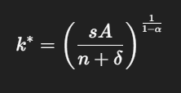
Steady-State Analysis
Economy converges to steady state
Long-run equilibrium
In the long run, the economy converges to a steady-state level of capital.

Slide 7
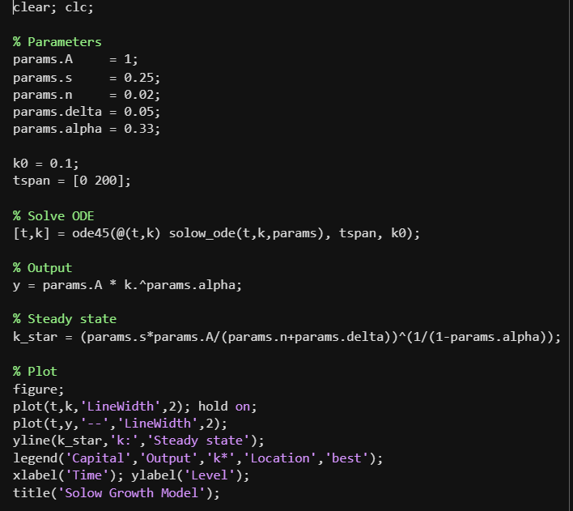
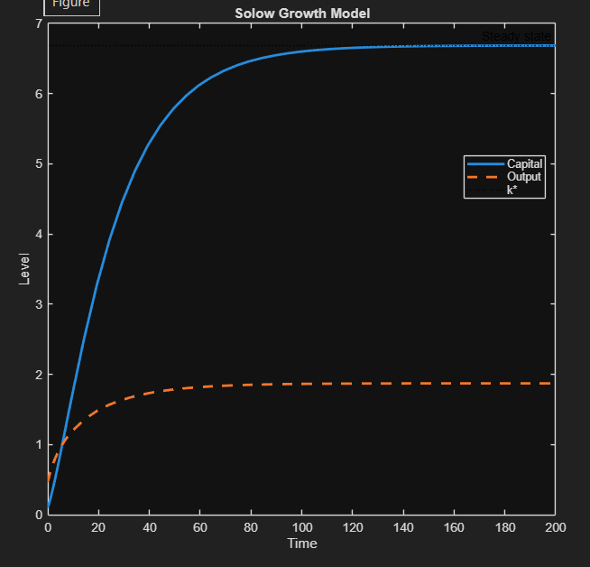
MATLAB Numerical Implementation
ODE solved using ode45
Separate function file
Numerical simulation
Steady-state verification
MATLAB is used to solve the model numerically and visualize the dynamics.

Slide 8
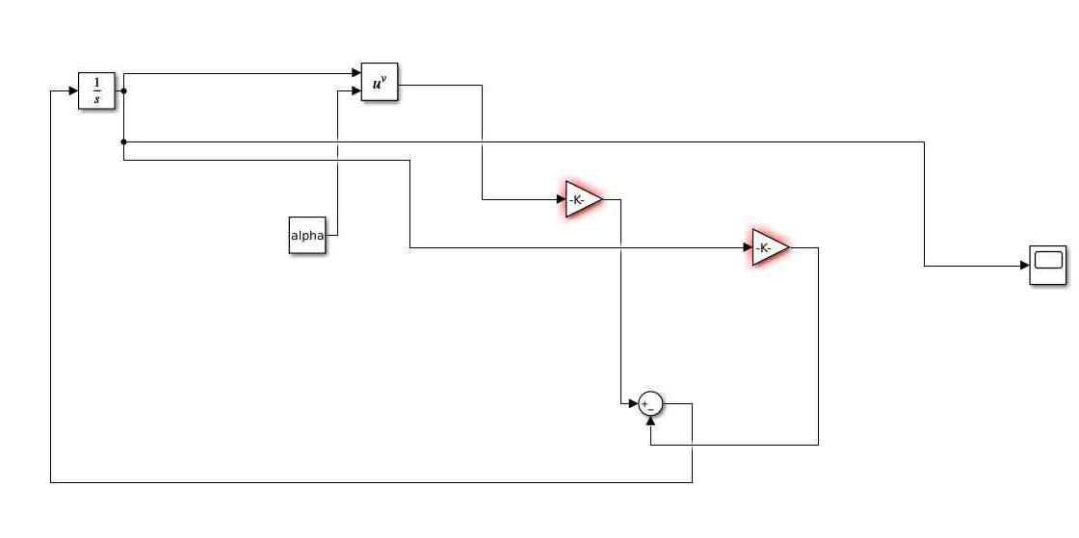
Simulink Model
Block diagram representation
Integrator for capital
Gain and Sum blocks
Scope for visualization
Simulink provides a visual representation of the differential equation.

Slide 9
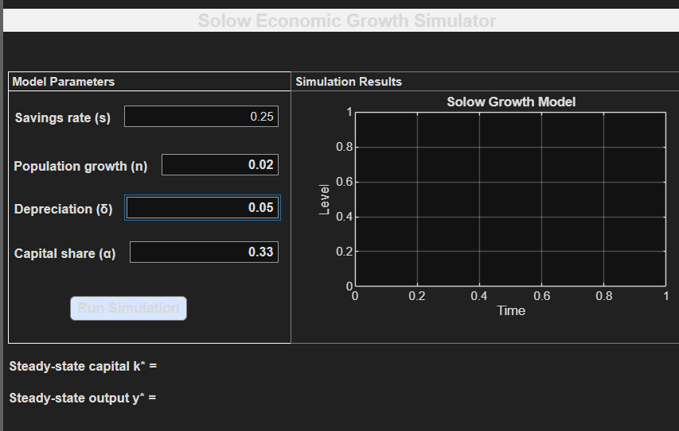
Graphical User Interface
Interactive parameter input
Real-time simulation
Automatic steady-state calculation
User-friendly design
The GUI allows users to interactively explore the model.

Slide 10
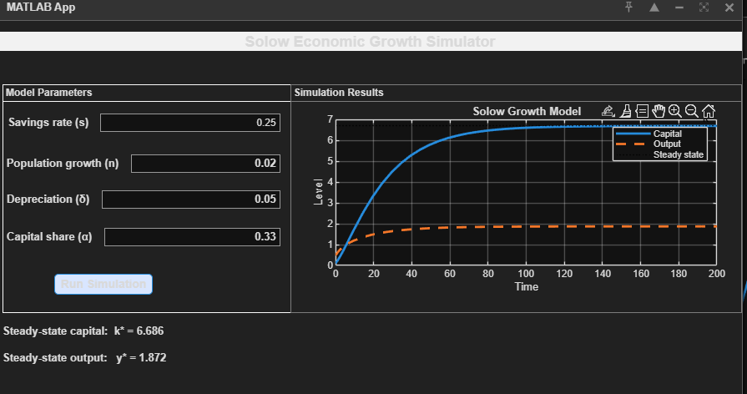
Simulation Results
Capital converges to steady state
Results match theory
Stable behavior
Simulation results are consistent with theoretical predictions.
This slide shows the simulation results obtained using the interactive GUI.
Capital and output converge smoothly to the steady-state values predicted by theory.

Slide 11
Conclusion
Model implemented successfully
MATLAB, Simulink, and GUI combined
Useful for education and analysis
The project successfully demonstrates economic growth dynamics.

